Slide 1


Multilingual Education through OCR and AI
Author(s)
Arbaaz Yaseen
Hritik Singh
Shaikh Mohammad Gous Mahebub
Affiliation(s)
Bharati Vidyapeeth College of Engineering, Pune
MITADTSoCiCon 2024

Slide 2
Outline
Introduction
Literature Review
Methodology
Results and Discussion
Future Scope
Conclusion
Acknowledgements
MIT-ADT-SoCiCon-2024

Slide 3

Introduction
What is multilingual education?
Language Barriers
The Role of AI
Personalized Learning
Language Translation
The Role of OCR
Digitizing Learning Materials
Unlocking Content Accessibility
MIT-ADT-SoCiCon-2024

Slide 4
Literature Review
Multilingual Education and Technology:
AI and OCR technologies aid language learning and collaboration (Zhu, 2020; Romanov et al., 2022).
Models and Approaches:
Tesseract OCR, EasyOCR, and Google Cloud Vision are key multilingual OCR models (Zulkifli et al., 2023).
AI techniques like LLMs and RL agents support teaching (Xu et al., 2021).
Challenges and Solutions:
Data scarcity and writing system disparities pose challenges (Zulkifli et al., 2023; Romanov et al., 2022).
Fine-tuning Tesseract OCR improves performance (Vasantharajan et al., 2022).
State-of-the-Art Advancements
Hugging Face Transformers excel in NLP tasks (Singh & Behera, 2022).
Personalized learning paths enhance efficiency (Smith et al., 2022).
MIT-ADT-SoCiCon-2024

Slide 5
Methodology
Content Processing Pipeline (Original Text Processing)
Text Processing
Transformer Summarization
GPT-4 Text Understanding
Course Outline Generation
Contextualization and Retrieval (Original Text Chunking)
User Interaction and Refinement
User Input (Chat Option)
Retrieval and Context Generation
MIT-ADT-SoCiCon-2024

Slide 6
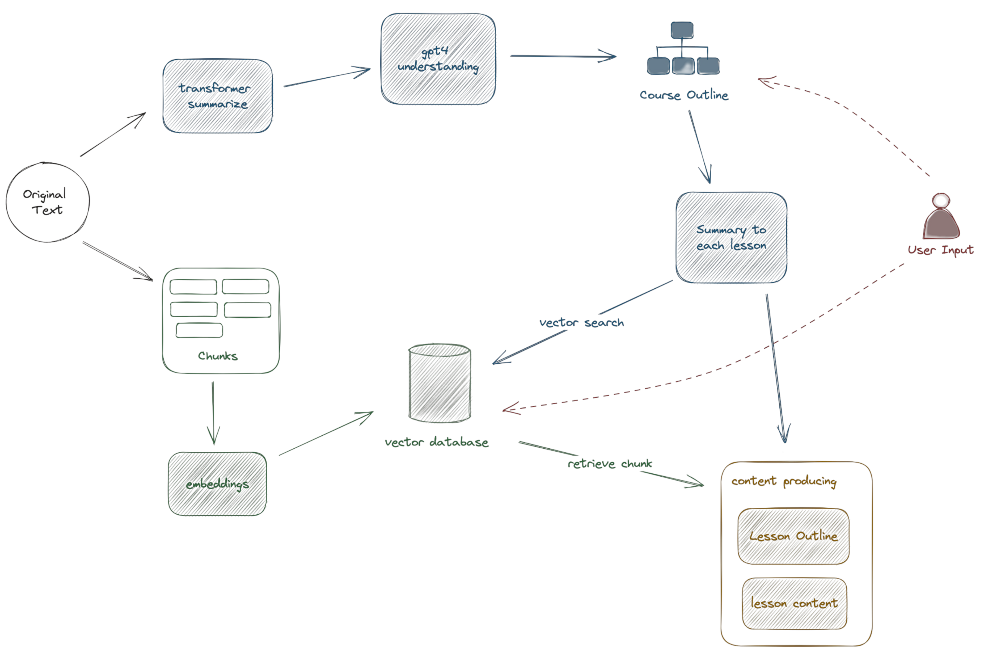

Slide 7
Result and Discussions
MIT-ADT-SoCiCon-2024

Slide 8
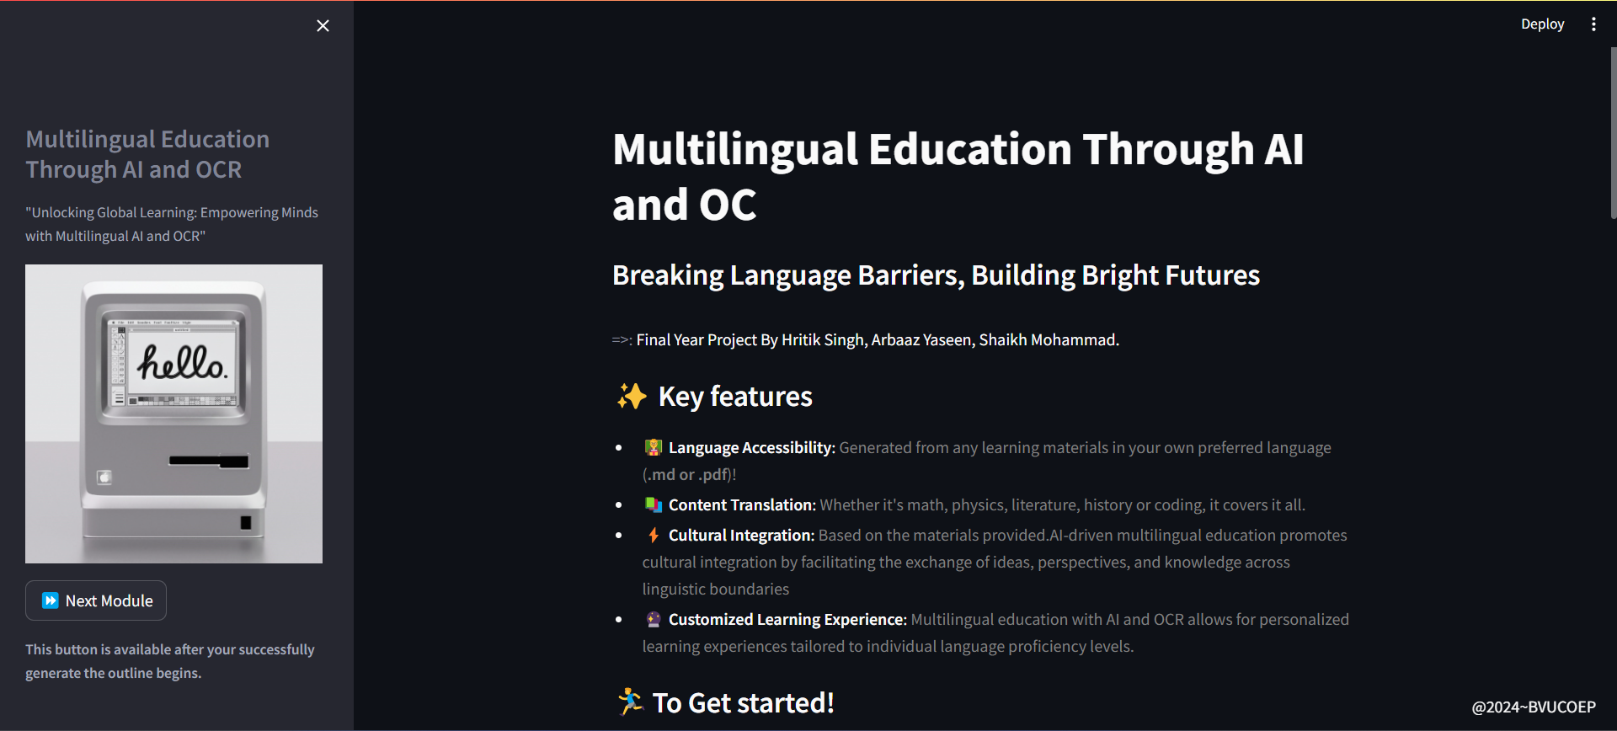
Web Application hosted on Local System: http://localhost:8501/
Side Bar Include title and caption of the project
Main page include a input form to upload the “gpt-api-key” and the pdf

Slide 9
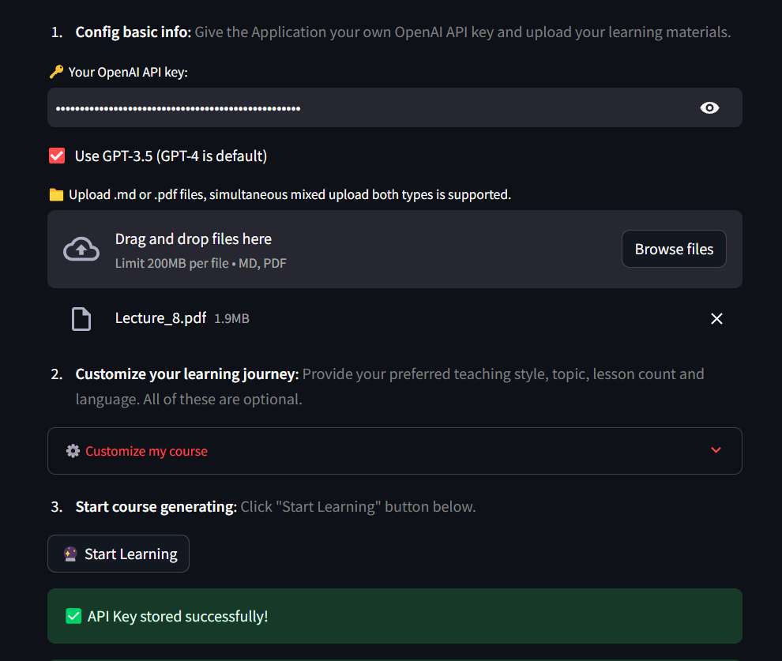
Here as One can See
Input Form include:
API key
Model Selection
PDF file upload option
A customization option for better learning experience
Course Outline Generate Button

Slide 10
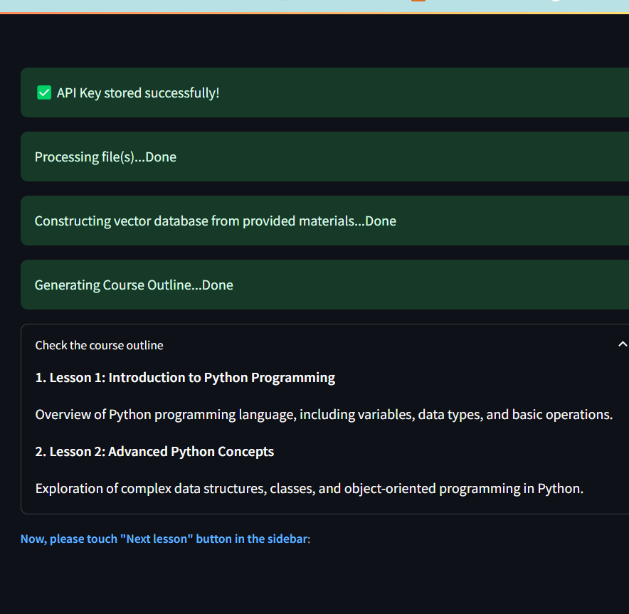
Generate outline
Pdf file parsing + vector db index generation
Gpt-turbo-3.5 output after taking the keywords generated by “nltk”

Slide 11
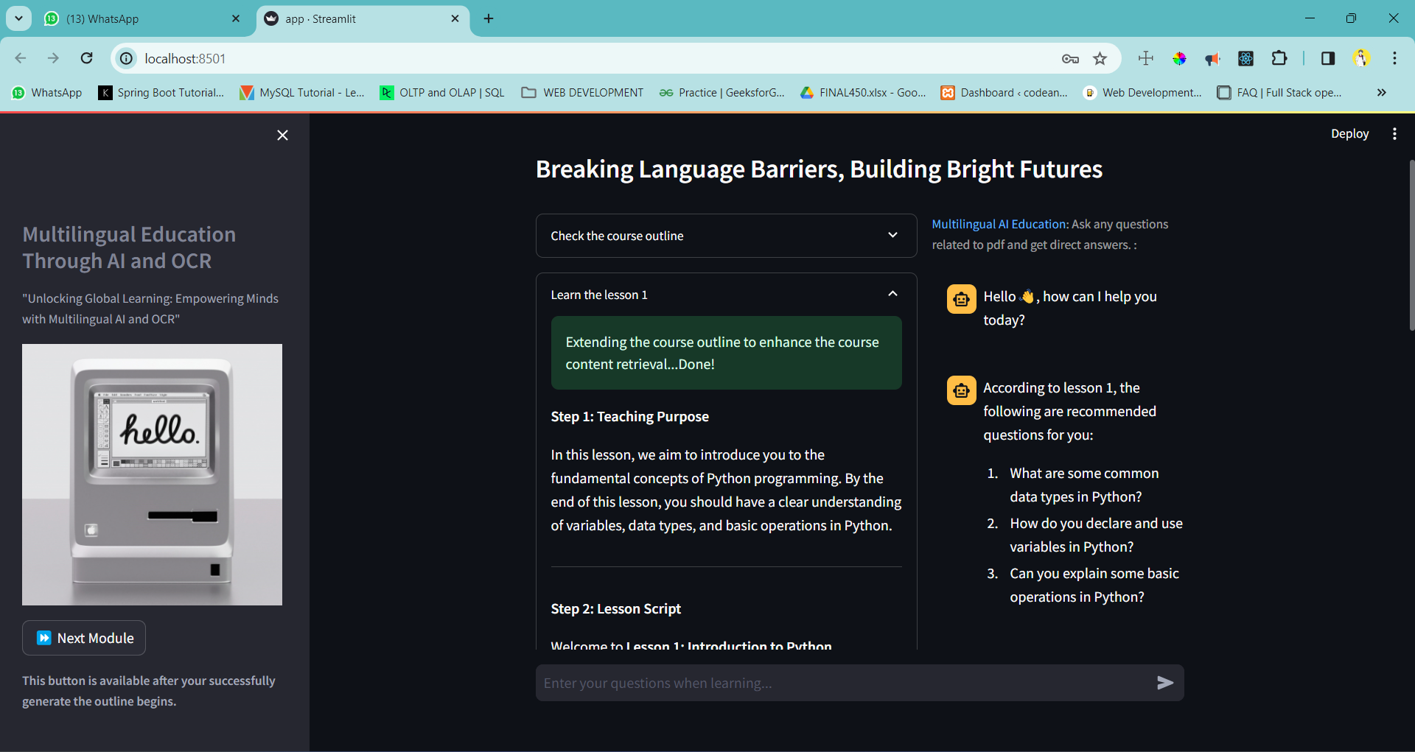

Lesson Generated
After Course outline is generated one can click next module to generate lessons based on course outline of the passed pdf

Slide 12
Future Scope
Audio Interaction with Students.
Interactive Image-based Learning model.
Video tutorial, based on text-to-video generation model
MIT-ADT-SoCiCon-2024

Slide 13
Conclusion
The future of education is personalized, accessible, and driven by technology.
This paper address, leveraging AI and machine learning, has the potential to revolutionize the learning experience for users of all backgrounds.
MIT-ADT-SoCiCon-2024

Slide 14
Acknowledgements
We extend our sincere gratitude to Prof. Dr. Mayuri H. Molawade for her invaluable mentorship and guidance throughout our research paper endeavor.
MIT-ADT-SoCiCon-2024

